Slide 1
Dialogue Visualization User Interface Ideas
April 2020

Slide 2
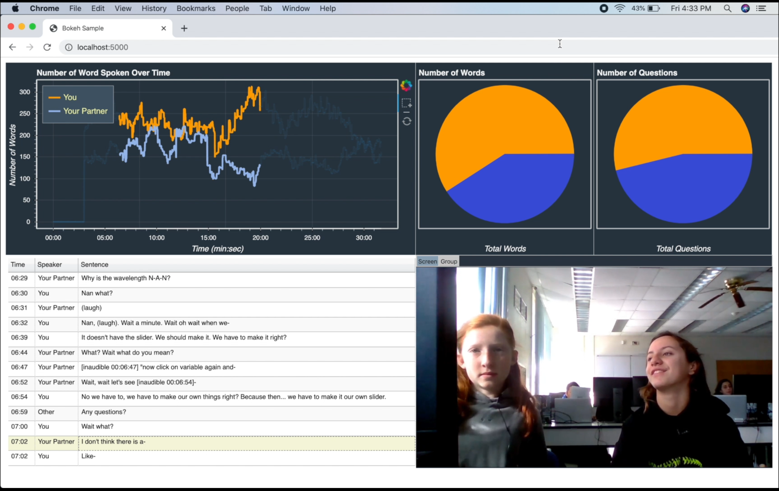

Slide 3
New Features
Children’s roles during pair programming
Extracting keywords from the pair dialogue
Classifying Question types (e.g., open and closed)
Where to locate them on the user interface?

Slide 4
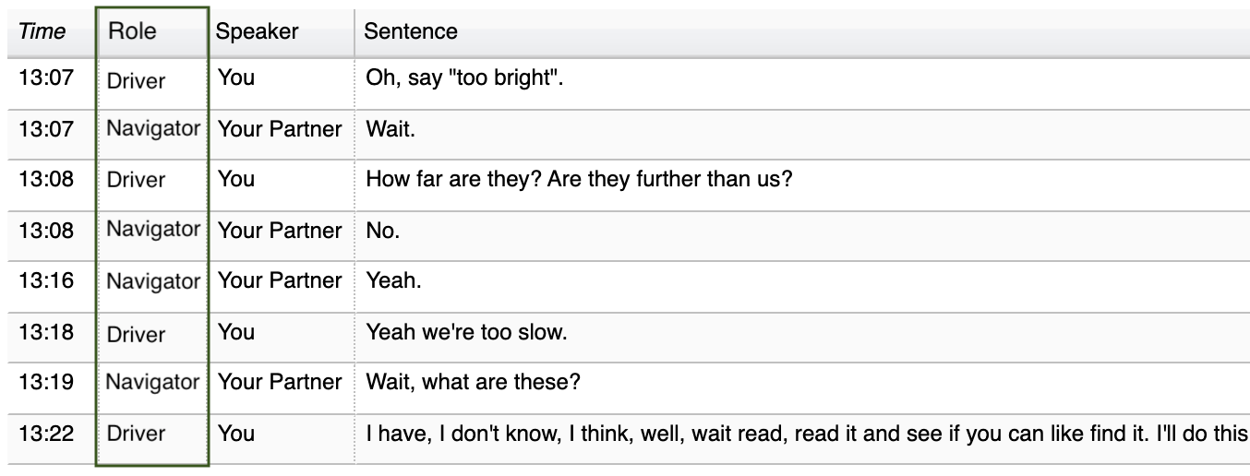

Slide 5


Slide 6
Keywords
Your team talked about …
Wavelength range
Variable
Basketball
Green color
Amplitude
…

Slide 7
Question Types
You asked 3 open questions and 7 closed questions in the selected part.

Slide 8
In the selected part, you and your partner talked about …
Wavelength range
Variable
Basketball
Green color
Amplitude
…
You asked 3 open questions and 7 closed questions in the selected part.

Slide 9
In the selected part, you and your partner talked about …
Wavelength range
Variable
Basketball
Green color
Amplitude
…
You asked 3 open questions and 7 closed questions in the selected part.
Open questions usually requires long responses and trigger deeper dialogues. For example, how do you change a variable?
Closed questions are usually require short responses. For example, where is the variable block?

Slide 10
Dialogue
Keywords and Questions
In the selected part, you and your partner talked about …
Wavelength range
Variable
Basketball
Green color
Amplitude
…
You asked 3 open questions and 7 closed questions in the selected part.
Open questions usually requires long responses and trigger deeper dialogues. For example, how do you change a variable?
Closed questions are usually require short responses. For example, where is the variable block?

Slide 12
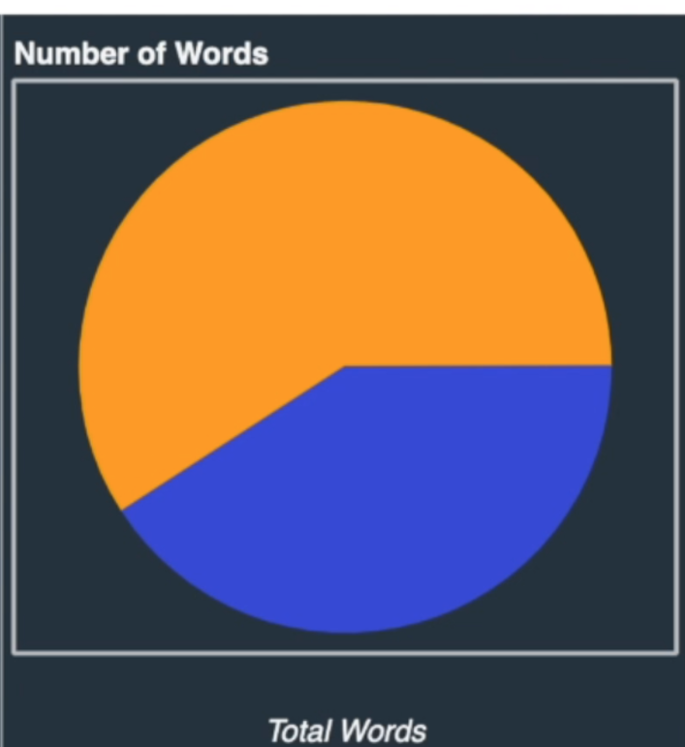
Keywords
Your team talked about …
Wavelength range
Variable
Basketball
Green color
Amplitude

Slide 15
Dialogue Data
The conversation is very shallow.
Short sentences, frequent turn-taking.
Students focus on completing the sub-tasks rather than the process.
Usually, no questions about how things work.
Competition for power is very visible.
Most of them completed the task.

Slide 16
Group | S1_TurnCount | S2_TurnCount | S1_WordCount | S2_WordCount | S1_Q_Count | S2_Q_Count | TotalWordCount
G10 | 294 | 316 | 1978 | 1658 | 36 | 34 | 4398
G06 | 106 | 64 | 693 | 342 | 24 | 14 | 1415
G01 | 465 | 324 | 2631 | 1615 | 30 | 42 | 4344
G20 | 120 | 90 | 598 | 434 | 31 | 7 | 1787
G15 | 193 | 128 | 737 | 728 | 24 | 11 | 1487
G22 | 248 | 237 | 1337 | 1059 | 59 | 48 | 2514
G02 | 131 | 84 | 506 | 273 | 23 | 13 | 870
G14 | 209 | 275 | 701 | 1098 | 23 | 35 | 2425
G09 | 131 | 141 | 709 | 854 | 11 | 18 | 2239
G05 | 147 | 164 | 792 | 975 | 19 | 24 | 1885
G04 | 243 | 111 | 1263 | 336 | 19 | 14 | 1703

Slide 17
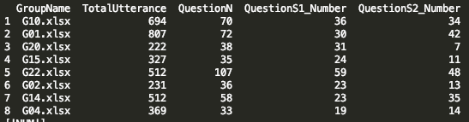
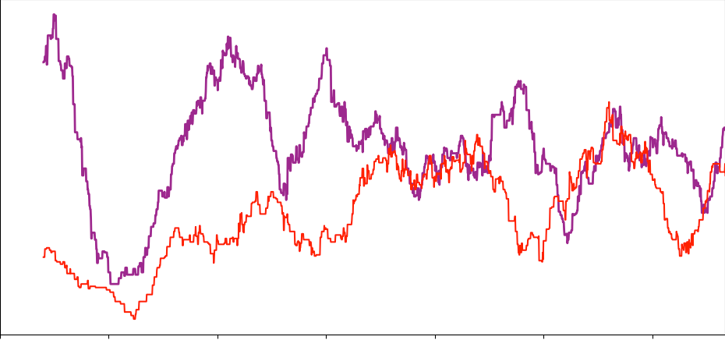
Goal: Exploring temporal dynamics of knowledge building interactions based on sequences of question-answers
Notes:
Does question-answer dynamics differ in good and bad groups differ in when the dialogue is not balanced

Slide 18
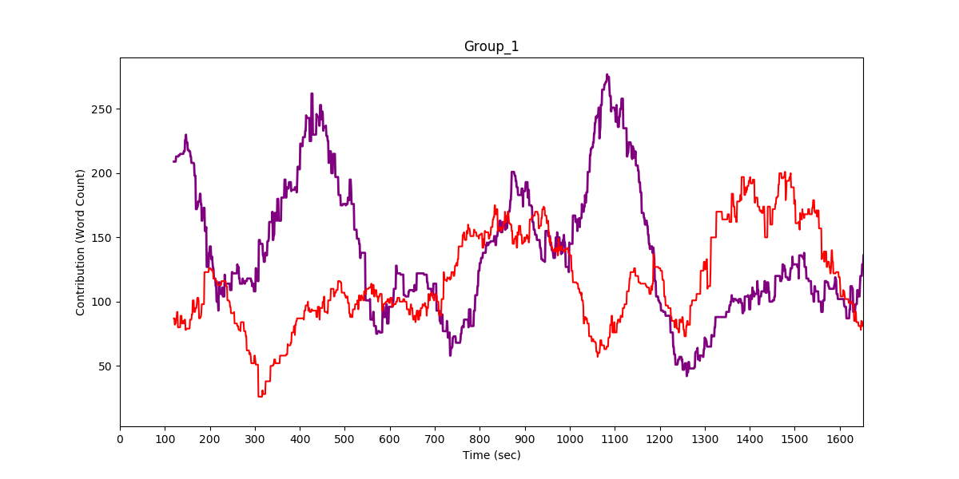
Early detection of power dynamics
Cumulative contribution scores can provide just a little.
Can we extract useful information from the parts with imbalanced contribution as well as equal contribution?

Slide 19
Early detection of power dynamics
Cumulative contribution scores can provide just a little.
Can we extract useful information from the parts with imbalanced contribution as well as equal contribution?

Slide 20
Time | Turn | Utterance | Q?
00:11:36 | S1 | You can also make it so that it changes.
00:11:39 | S2 | Yeah, but like -- oh okay.
00:11:54 | S2 | How did they -- how did they make the ball faster in the ping pong game? | S2_Q
00:11:54 | S1 | So, what are you trying to do?
00:11:59 | S2 | Like, we had to change amplitude by that. But that's only in the thing. It didn’t change it like --
00:12:06 | S1 | Well, you have to push the little green flag.
00:12:07 | S2 | I know, but --
00:12:12 | S1 | See? It's working. | S1_Q
00:12:12 | S2 | What? | S2_Q
00:12:14 | S2 | What? | S2_Q
00:12:15 | S1 | Did you not see it? Wait -- | S1_Q
00:12:16 | S2 | I changed by five. That's not five.
00:12:18 | S1 | Yeah.
00:12:19 | S1 | It continues to change it by five.
00:12:21 | S1 | Forever.
00:12:23 | S2 | That's quick.
00:12:24 | S2 | Umm...that's a little fast.

Slide 21
Hypothesis
Shortly after a student asks a question, if the other student is also asking a question (let’s say in the next 3-5 utterances), one student is explaining some students are exchanging ideas.
During imbalanced contribution times, if both students are asking questions the the struggle for power is low. However, if
If there is low number of questions and the low speaking students is only using confirming words such as ok, the other student can be dominating the work and control.
…

Slide 22
Research Questions
Steps:
Identify all the questions during the teamwork and categorize them based on Bloom’s Taxonomy (Knowledge, Comprehension, Application, Analysis, Synthesis, Evaluation)
Identify all the responses (next 1-3) utterances after each question
Identify each thread based on its contribution to knowledge building effort (None-somewhat-yes).
Research Question 2: Can question-answer types be used to predict productivity of the dialogue?
Research Question 1: What are the question-answer type distribution differences between productive and unproductive groups?
Distribution of on-topic and off-topic dialogue

Slide 23
Study Design
Day 1: Reviewing previous CS concepts and teaching cloning concept (OOP) to prepare them for the study next day. Probably, none of the students has knowledge about cloning topic.
Day 2: Evolution Science Activity: Students will use conditionals, loops, variables and OOP CS concepts to create a model that shows how a species can change through generations based on its ability to access food. Students will be working in groups and their dialogues will be audio/video recorded.
Day 3: Students who were recorded during Day 2 activities (about 16 groups) will be divided into two groups. The first group will be given several graphs that show their previous dialogue activity.
Day 4: Students will be doing another Science activity (probably another Evolution topic) and their interactions will be recorded.

Slide 24
Peer Evaluation
1. I liked working with my partner today.
2. My partner did his/her fair share today.
3. My partner contributed to the discussion during the activity today.
4. My partner helped me when I asked for help today.
5. My partner encouraged me today.
6. My partner valued my ideas today.
7. My partner expressed his/her opinions with confidence today.
8. I found my partner easy to work with today.
9. I felt empowered while working with my partner today.
10. My partner cooperatively followed the pair programming model (rotating roles of driver and navigator).
11. How would you assess the motivation of your partner relative to yourself?
12. How would you assess the coding ability of your partner relative to yourself?
13. Do you have any other comments about playing the game with your partner?
Notes:
12. How would you assess the coding ability of your partner relative to yourself?

Slide 25
Survey Questions After Day 2
I was satisfied with my contribution to the group decision making
I was aware of my conversational skills during the discussion (I was able to effectively communicate with my partner).
I was aware of my teammates’ conversational skills during the discussion. (My partner was able to effectively communicate with me).
The discussion was productive.
The discussion was enjoyable.
The group had a positive vibe.
I had a positive attitude.
I could have spoken less.
I could have spoken more.
My partner often cut off my speech.
I would like to have discussions with this partner in future.
I felt comfortable asking my partner questions.
My partner was comfortable asking me questions.
I answered my partner’s questions with sufficient details.
My partner answered answered my questions with sufficient details.
I used appropriate language during discussion
My partner used appropriate language during discussion.
Overall, I was a good partner.

Slide 26
Survey Questions after Day 3 (Graphs)
The feedback on participation was easy to understand.
The feedback on turn-taking was easy to understand.
The feedback on participation was accurate.
The feedback on turn-taking was accurate.
The graphs were easy to understand. ?
The feedback was relevant.
The feedback graphs were engaging.
Notes:
Participation: The first graph will show their participation as word counts and turn taking. They will be encouraged for balanced participation. – Line Graph
Number of questions asked (and question types) – each student/Total – expected?
Number of questions responded (and question quality) – each student/Total – expected?
Language use (profanity check etc.) - Examples
Ratings based on peer, teacher, and researchers’ observations. Rating out of 5 (can be a smiley face)

Slide 27
Survey Questions after Day 3 (Graphs and Videos)
The feedback on participation was easy to understand.
The feedback on participation was accurate.
The feedback on turn-taking was easy to understand.
The feedback on turn-taking was accurate.
Also the same question about Question, Answer, language use, evaluation.
The graphs were easy to understand. ?
The feedback was relevant.
The feedback graphs were engaging.
Notes:
Participation: The first graph will show their participation as word counts and turn taking. They will be encouraged for balanced participation. – Line Graph
Number of questions asked (and question types) – each student/Total – expected?
Number of questions responded (and question quality) – each student/Total – expected?
Language use (profanity check etc.) - Examples
Ratings based on peer, teacher, and researchers’ observations. Rating out of 5 (can be a smiley face)

Slide 28
Graph Feedback
5 main graphs:
Participation: The first graph will show their participation as word counts and turn taking. They will be encouraged for balanced participation. – Line Graph
Number of questions asked (and question types) – each student/Total – expected?
Number of questions responded (and question quality) – each student/Total – expected?
Language use (profanity check etc.) - Examples
Ratings based on peer, teacher, and researchers’ observations. Rating out of 5 (can be a smiley face)

Slide 29
Video Feedback
5 main points – 1 minute video chunks showing 2 examples of each of the following.
Participation: The videos will show the moments that they took complete control of the task and prevented their partner’s contribution.
Number of questions asked (and question types) – each student/Total – expected? Openness to suggestions
Number of questions responded (and question quality) – each student/Total – expected?
Language use (profanity check etc.) – Examples
…

Slide 30
Research Questions
Steps:
Identify all the questions during the teamwork and categorize them based on Bloom’s Taxonomy (Knowledge, Comprehension, Application, Analysis, Synthesis, Evaluation)
Identify all the responses (next 1-3) utterances after each question
Identify each thread based on its contribution to knowledge building effort (None-somewhat-yes).
Research Question 2: Can question-answer types be used to predict productivity of the dialogue?
Research Question 1: What are the question-answer type distribution differences between productive and unproductive groups?
Distribution of on-topic and off-topic dialogue

Slide 31
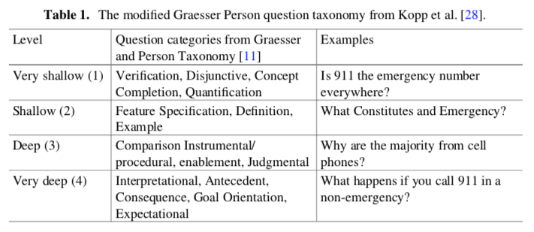
Question classification using RNN (Trausan-Matu)
Notes:
The coding process classified the questions according to the depth of the question (from 1-very shallow to 4-very deep). These differences in depth were annotated as (1) required answers are typically one word (e.g., yes or no), (2) required answers are still very short but may involve two or more elements (e.g., definitions), (3) required answers are longer, but do not relate to causal mechanisms (e.g., comparisons of two entities), and (4) required answers are lengthy and address systems’ causal functions (e.g., which ante‐ cedent led to a consequence).

Slide 32
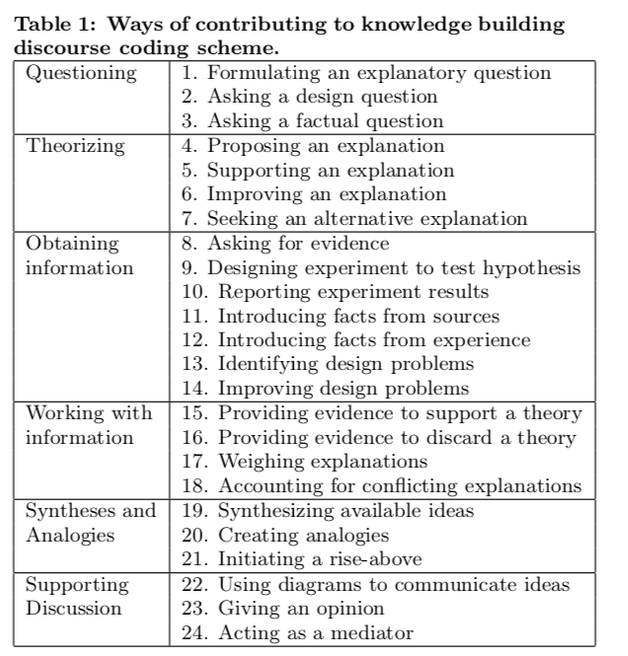

Slide 34
Early detection of power dynamics
How does the distribution of POS tags change through time?
ICAP, Negotiation frameworks…
How can we identify when a pair becomes more passive and what happened right before that?

Slide 35
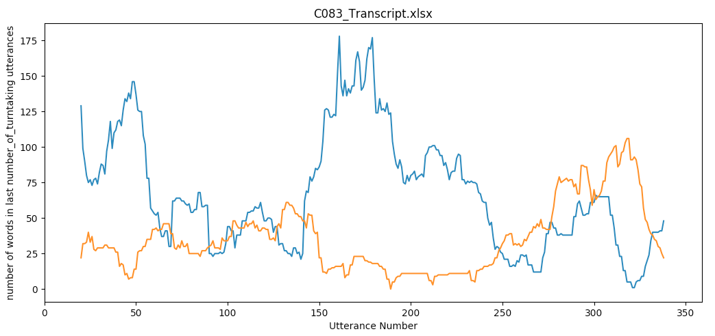
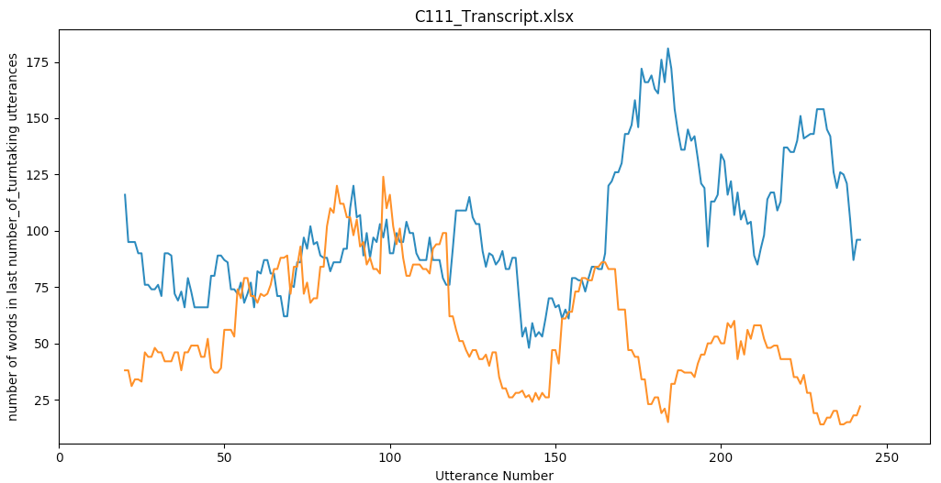
CS1 Collaboration Group Power Dynamics
Balanced

Slide 36
QUANTITATIVE ANALYSIS OF COLLABORATIVE DIALOGUE
Occurrence of One Student Dominating the Collaboration
The distribution of total utterances for each pair of students, calculating the proportion of the total utterances that came from the more “talkative” partner.
Prior research on equitable collaboration has established that we must look beyond overall distributions and also examine the content of students’ talk (Shah et al., 2014).
In collaborative gameplay, one can imagine a scenario in which two students make an equivalent number of utterances, but while Student A makes many suggestions about how to

Slide 37
Study
Goal: Identify quantitative metrics that can be used to predict task success or discriminate between successful and unsuccessful groups involved during the activity. For example: Identification of knowledge sharing in discussion.
“bag-of-words” features: Only the vocabulary used in a conversation
“complex language” features. Adjacent pairs of words (bigrams) and local syntactic part-of-speech bigrams
Several frameworks
Argumentative knowledge construction
ICAP
Active learning
Social network theory for analyzing interactional exchange patterns (Fahy et. al ,2001)

Slide 38
Argumentative knowledge construction
P J Fahy, G Crawford, M Ally : Patterns of Interaction in Computer Conference Transcript, The International Review of Research in Open and Distance learning, 2001
Argumentative knowledge construction considers multiple dimensions of analysis:
1. Participation,
2. Heterogeneity of Participation,
3. Epistemic dimension,
4. Argumentative dimension and
5. Social Modes of Reconstruction.
Armin Weinberger, Frank Fischer, A framework to analyze argumentative knowledge construction in computer-supported collaborative learning, Computers & Education, Volume 46, Issue 1, January 2006, Pages 71-95

Slide 39
Active Learning Annotation
Five types of “Active Learning” moves (can be increased):
– Proposals (PR) begin a sequence and introduce a new concept or idea.
– Questions (QU) target proposals and question them.
– Clarifications (CL) are elaborations on proposals, or answers to questions.
– Agreements (AG) show agreement or assent between speakers in a sequence.
– Remaining contributions are Comments (CM); including topic statements, floor grabbing moves, pauses, etc.

Slide 40
Helpful Papers
Contains a fairly comprehensive survey of initial conversation analysis methods.
B.D Wever, T. Schellens, M. Valcke, H. Van Keer : Content Analysis Schemes to Analyze Transcripts of Online Asynchronous Discussion Groups, Computers & Education, Volume 46, Issue 1, January 2006, pages 6-28
Following work has shown that identification of such sequences in conversation is possible with a high degree of accuracy and can even be done in real time, using machine learning techniques.
Elijah Mayfield, David Adamson, Carolyn Penstein Rose : Hierarchical Conversation Structure Prediction in Multi-Party Chat, SIGDIAL 2012
Amy Soller, Janyce Wiebe, Alan Lesgold : A Machine Learning Approach to Assessing Knowledge Sharing During Collaborative Learning Activities, Proceedings of Computer-Support for Collaborative Learning 2002, Boulder, CO, 128-137.
Elijah Mayfield, David Adamson, Alexander I. Rudnicky, Carolyn Penstein Rose :Computational Representational of Discourse Practices Across Populations in Task-Based Dialogue, ICIC, Bangalore, 2012

Slide 41
Instead of individual turn level or the utterance level, but rather, the sequence level. Reasons:
The sequence level captures the relevant context (sequential information) for each utterance it contains, which can then be used to identify the active learning role played by it, using rule based transformations.
The sequence level brings together related contributions (based on content) by the collaborating group members, which are usually related by a causal/reply structure.
The existence of appropriate context and causal/reply structure makes it ideal for identifying the trends highlighted in the previous section, which have been shown to be associated with knowledge acquisition.

Slide 42
Method – Data Preparation
Take 4 groups that have the highest and lowest learning gain, satisfaction etc. –Two each
Transcribe and annotate all the videos for 12 weeks. (each group will take 6 hours=24 hours in total)
Annotate the data based on one of the frameworks (Active Learning etc.)

Slide 43
See if ratio of the tags (proposal/questions etc) correlates with the learning outcomes and satisfaction, if yes what are the differences
Analyze the tag sequences (n-gram or HMM )
There are two ways of training data.
One group
Based on one group every week and accumulate the training data. Test it.
each week n-1 weeks and test it
See how many weeks would be sufficient to achieve desirable accuracy
Multiple groups from the same week- Train and test it on a new group
How much of the focus is related to the study context?
If out of context, does it help building positive relationship with the partner?
If out of context, is it related to the power dynamics between pairs?

Slide 44
Also…
What happens after students fail or get stuck?
What are the first things they try to do?
Do they blame each other? Are they getting angry easily?
What are the suggestions? Ratio s
When do they ask for help?
The order of turns
For example, Student A A A A B B A B B B or A B A B A B A (number of sentences spoken in each turn)
PS: Turn Taking dynamic is important

Slide 45
Revised Research Questions
How do the groups differ
Learning Activities
Science
See Phil’s plans

Slide 46
Convert the transcript meta-data to a way that instructor/researcher can gain a quick insight into the flow of the conversation.
There is a focus on preventing dominant participants to take over the discussion and having less talkative participants to express their opinions (Bergstrom & Karahalios, 2007a).
Visualising data concerned with language and dialogue patterns has also been an approach in the field of design research and educational research providing participants a communal social mirror (cite)
experiments have been made to investigate whether one could change group dynamics in a design discussion by providing participants with a visual live feedback of their contribution to a conversation in terms of speaking time and sound level (Bergstrom & Karahalios, 2007a;
Similarly, group performance was observed to correlate with speaking turns, speaking lengths (W. Dong, Lepri, Kim, Pianesi, & Pentland, 2012)
Avci & Aran (2016) developed a method for prediciting group performance. Their method take inputs such as ‘group speaking cues’, ‘group looking cues’, ‘personality trait statistics’, ‘Individual Speaking Statistics’, ‘Individual Performance Statistics’, ‘Group perception Statistics’, ‘Influence Cues’, ‘Hierachy Cues’ and ‘Frame-Based Features’. Based on case studies, they succeed in predicting the performance of groups when making decisions.
- presents Temporal Static Visualisations (TSV) of the group members individual contribution as well as the mean-variance in participation over time. This supports the researcher in identifying sequences of and transitions between monologues, dialogues and group discussions in the observed conversation.
The main strength of TSV lies in the static inclusion of time development that helps the researcher to gain a quick insight into the flow of the observed conversation.

Slide 47
Visualize the data
TSV, Gephi and Cytoscape
Creating data visualisations of speaker-turns and amount of speech (word count), By converting data from the trancsriptps into a csv.- file, we were able to both statically and dynamically show the communication flow of a discussion.

Slide 48
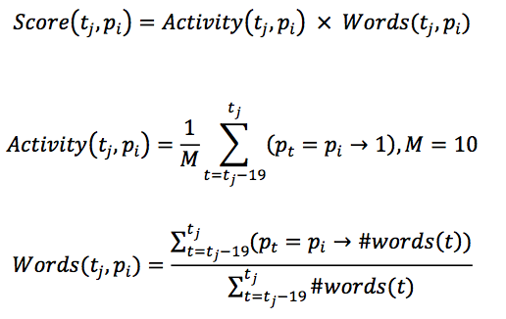
5.1 Mathmatical Explanation of TSV
Each individual participant pi in the conversation is given a score denoting their contribution to the conversation over the last 20 speaker turns t. We define Score as a function of tj and pi (Equation 1). tj is a given speaker turn (denoted ### in the supplied transcripts), e.g. tj = 25. and pi is a given participant, e.g. pi = pk meaning Kenny. The calculated score is the product of participant activity and recent word contribution. Activity (Equation 2) is a ratio describing how many times the given participant has contributed to the conversation in the last 20 turns in relation to the maximum contributions possible, M. Over the time period of 20 turns, the maximum possible speaker turns of one participant is ten - this would indicate the person speaking every second time in the sequence of 20 speaker turns. Words (Equation 3) is the ratio of words spoken of the given person over the last 20 turns in relation to the total number of words spoken in the same time period.

Slide 49
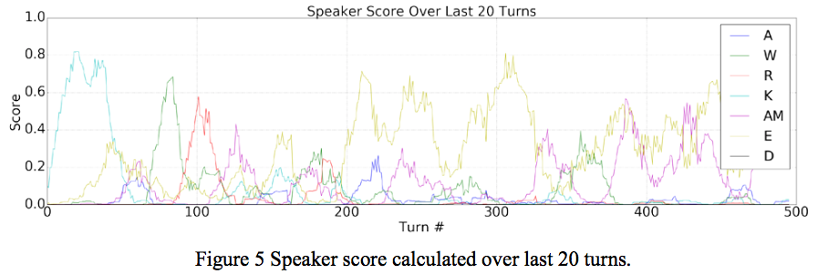

Slide 50
In order to identify modes of information sharing rather than individual contributions we calculated the variance of the score for each speaker turn to visualise the spread of activity among participants (Equation 4). This give an indication of periods of equal and more one-sided participation respectively.

Slide 51
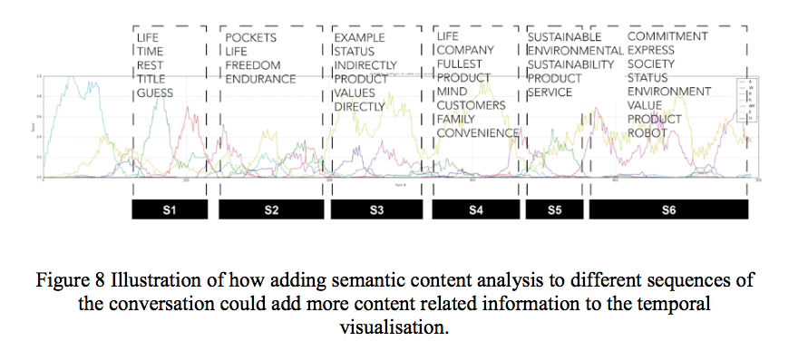

Slide 52
In Team Left, 37.8 % of speaker turns are classified as high variance, and 31.3 % as low variance. We find this in the speaker score plots (Figure 5) as a sequence of single participants dominating the conversation in turns. In contrast, for Team Right only 2.4 % of the speaker turns are high variance, and 72.1% low variance. The conversation of team Right can be seen in Figure 6 as frequent exchanges throughout the whole session by multiple participants, with only shorter segments where one participant sticks out.

Slide 53
After finding the important parts, focus on them deeply either by quantitative content analysis or qualitative analysis.

Slide 54
TO DO
Understand the phases in the transcription

Slide 55
Analysis of Dialogue: Identifying Modes of Information Sharing
Notes:
Temporal Static Visualisation of Transcripts for Pre-Analysis of Video Material: Identifying Modes of Information Sharing
There is a focus on preventing dominant participants to take over the discussion and having less talkative participants to express their opinions (Bergstrom & Karahalios, 2007a).

Slide 56
Can we identify the navigator and driver?
When one student is dominant in the conversation, maybe that student is driver (or navigator).

Slide 57
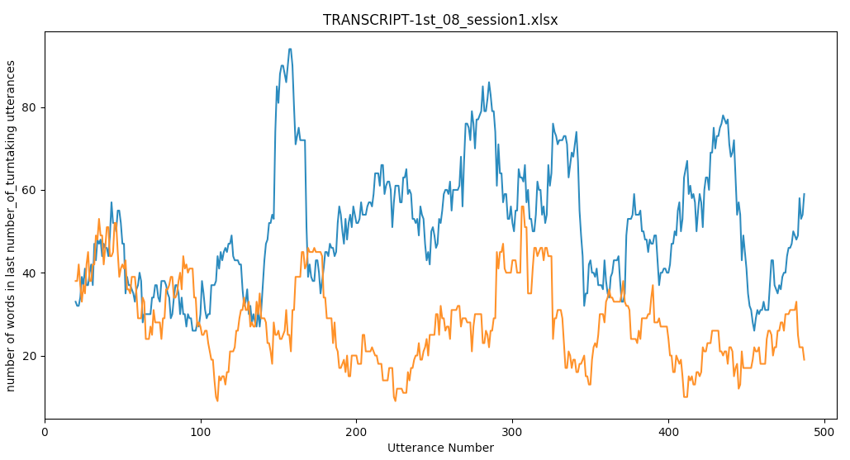
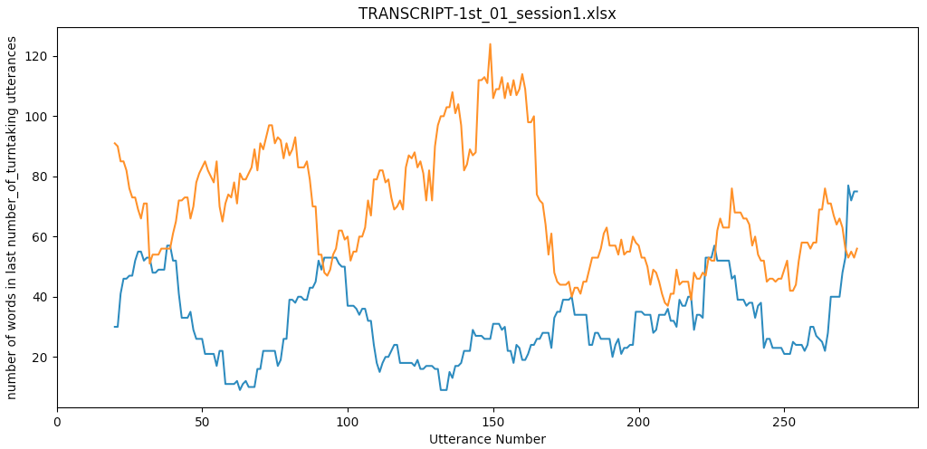
Middle School Collaboration Power Dynamics
Domination after a short time
Domination from the beginning

Slide 58
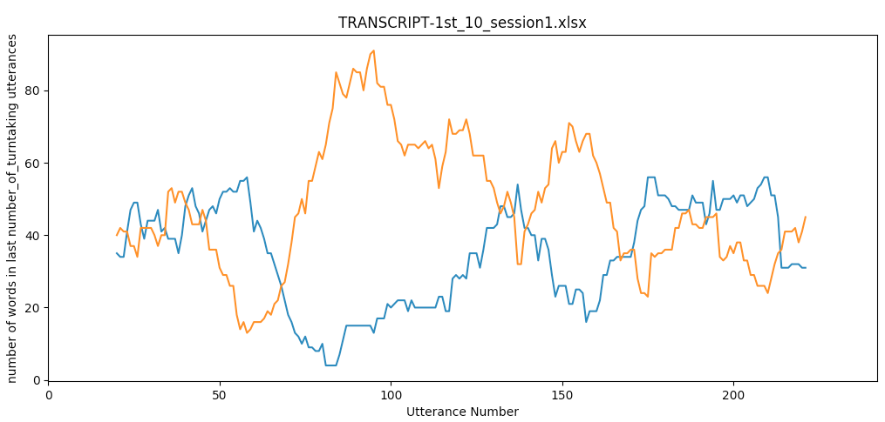
Middle School Collaboration Group Power Dynamics
Power dynamic changes through time

Slide 59
CS1 Collaboration Group Power Dynamics
Balanced

Slide 60
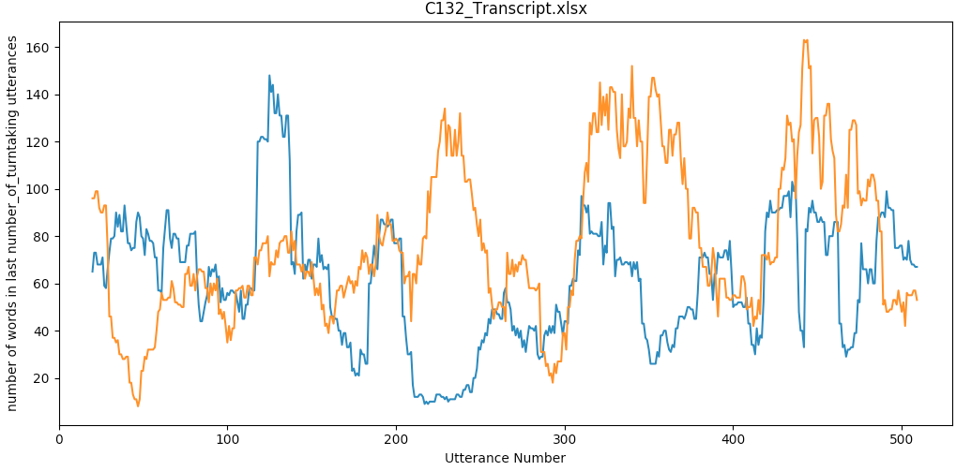
CS1 Collaboration Group Power Dynamics
Power dynamic changes through time

